Slide 1
UNIT 3 MULTIMEDIA SYSTEMS DESIGN
NANCY VICTOR
AP, SITE,
VIT UNIVERSITY, VELLORE

Slide 2
What is Multimedia????

Slide 3
Multimedia
Multi
Many, multiple
Media
Means of distribution and presentation of information.

Slide 4
Means….
In everyday life…
Multimedia is everything you hear or see.
e.g. text in books, sound in music, and graphics in pictures.
In computing environment…
Multimedia is the presentation of information by a computer system using text, sound and graphics.

Slide 5
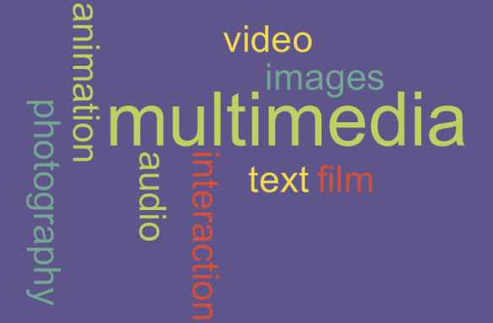
Multimedia is…

Slide 6
Definitions
Multimedia is any combination of text, graphics, sound, animation and video delivered by computer or other electronic means.
Multimedia can support multiple representations of same pieces of information in a variety of forms.

Slide 7
Medium
Media can be classified with respect to different criteria:
Perception Medium
To sense the environment.
Seeing-> text, images, video
Hearing-> music, noise and speech
Representation Medium
Internal computer representation of information.
Text character->ASCII
Graphics-> CEPT, CAPTAIN
Audio Stream-> PCM
Image-> JPEG
Audio/Video-> MPEG
Presentation Medium
Tools for the input and output of information.
Output Media-> Paper, Screen, Speaker
Input Media-> Keyboard, Mouse, camera, microphone

Slide 8
Storage Medium
Data carrier which enables storage of information.
Floppy Disk, Hard Disk, CD-ROM
Transmission Medium
Information carriers
Wired Networks
Wireless Networks
Information Exchange Medium
All information carriers for transmission: storage and transmission media
Using computer networks or E-mail system.

Slide 9
Properties of Multimedia System
Combination of media
Independence
Computer-supported Integration
Communication Systems

Slide 10
A Multimedia system is characterized by computer-controlled, integrated production, manipulation, presentation, storage and communication of independent information which is encoded at least through a continuous (time-dependent) and discrete (time-independent) medium.

Slide 11
Current Trends…
In 1970’s and 1980’s-> video games, electronic encyclopedias etc.
In 2013-> Digital Library, Video-on-Demand, Interactive Television, Video Conferencing.
Wireless Multimedia Sensor Networks
Voice Recognition, Finger Gesture Recognition, Smart TV Services such as On Now.

Slide 12
MULTIMEDIA APPLICATIONS

Slide 13
Document Imaging
Document Imaging means the conversion of paper files (of any size or description) or microfilm / fiche to digital images.
Image Processing and Image Recognition
Image processing is the any form of signal processing for which the inputs and is an image, such as photographs or frames of video. The output of the image processing can be either an image or a set of Characteristics or parameters.
Full Motion digital video applications
A Full-Motion Video (FMV) is the rapid display of a series of images by a computer in such a way that the person viewing it perceives fluid movement. An FMV can consist of live action, animation, computer-generated imagery or a combination of those formats. It typically includes sound and can include text superimposed over the video.
Electronic Messaging
One to One communication: (Instant message, Personnel message, Email)
One to Many communications: (Bulletin board system , Internet forum)
Universal Multimedia applications
It works with Digital Video or Photo Cameras, Web Cameras, C C T V Cameras, TV Tuner cards, Video Recorders.

Slide 14
MULTIMEDIA SYSTEM ARCHITECTURE

Slide 15
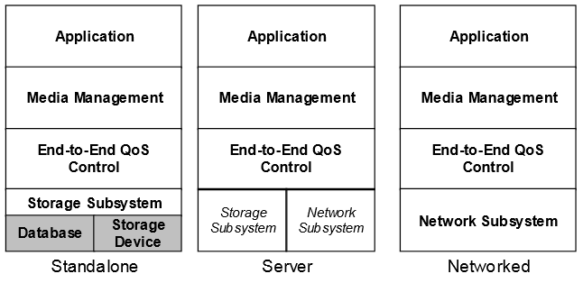
MULTIMEDIA SYSTEM ARCHITECTURE (Real time)

Slide 16
The lower layer provides services that are utilized by higher layers to perform their functions.
Layer 1: (Storage Subsystem and Network Subsystem)
Theses services are central to he functioning of multimedia system and is provided as part of the operating system services.
Layer 2: (End-to-End QoS)
This deals with maintaining connections between the source of multimedia content and the destination.
Layer 3: (Media Management)
Deals with media synchronization and media stream management.
Layer 4: (Application)
Interface with the user to provide access and controls to the presentation.

Slide 17
EVOLVING TECHNOLOGIES FOR MULTIMEDIA SYSTEMS

Slide 18
Hypermedia documents:
Hypermedia documents are computer-based documents that contain text, graphics, audio and video on pages that are connected by navigational links. The navigational links, often referred to as the hyperlinks, permit non-sequential or non-linear traversal of the document by the readers.
HDTV and UDTV:
HDTV is a digital TV broadcasting format where the broadcast transmits widescreen pictures with more detail and quality than found in a standard analog television, or other digital television formats.
Ultra-high-definition (UHD) television, also abbreviated UHDTV, is a digital television display format in which the horizontal screen resolution is on the order of 4000 pixels (4K UHD) or 8000 pixels (8K UHD).

Slide 19
3D Technologies and Holography
Holograms are images capable of recording 3D information on a flat piece of film by using the interference of light, typically laser light.
Because a hologram can capture more than just one image, it is capable of replaying the many different points of view, giving the look around effect of 3D.
Fuzzy Logic:
Fuzzy logic is a superset of conventional (Boolean) logic that has been extended to handle the concept of partial truth -- truth values between "completely true" and "completely false".
Digital Signal Processing:
Digital signal processing (DSP) is the numerical manipulation of signals, usually with the intention to measure, filter, produce or compress continuous analog signals.

Slide 20
DEFINING OBJECTS FOR MULTIMEDIA SYSTEMS

Slide 21
Text
Images
Audio
Video

